Slide 1
Amazon Web Services
Building an Interactive
AWS Quiz Chatbot
Team Members
● Phenyo
● Tumelo
Using Amazon Lex
● Malaza
● Grace
An AI-powered chatbot designed to test learners' knowledge of AWS services.
Project: AWS Lex Chatbot Creation Client: CloudLearners Inc.
Presenter: Phenyo
1 / 11

Slide 2
What is a Chatbot?
A chatbot is a software program that simulates human conversation with users
Examples
Uses Natural Language Processing (NLP) to understand intent
🤖 Customer Service Bots
Can understand user requests and respond automatically in real time
🎙️ Virtual Assistants
📚 Educational Learning Bots
Our project focuses on building a chatbot using Amazon Lex.
Presenter: Phenyo
2 / 11

Slide 3
Client Request
CloudLearners Inc. needed:
🎯 What is our main Goal ?
An interactive chatbot for learners
Help students learn AWS concepts through conversation.
A knowledge quiz about Amazon S3
Multiple choice questions
Instant feedback for answers
A simple and engaging learning experience
Presenter: Phenyo
3 / 11

Slide 4
Our Chatbot Solution
We built an interactive quiz chatbot using Amazon Lex.
▶
Start Quiz
❓
AWS Questions
Users start with commands like "Start Quiz"
The chatbot asks AWS-related questions
🔤
Multiple Choice
✅
Instant Feedback
Users answer with A / B / C options
The bot provides immediate correct/incorrect responses
Presenter: Tumelo
4 / 11

Slide 5
Why This Solution Is Valuable
Benefits for CloudLearners Inc.
🤖 Automates learning assessments
🎮 Provides interactive education
⚡ Gives instant feedback to learners
📈 Can scale to thousands of users
💰 Reduces need for manual trainers
Key Impact: Makes AWS learning more engaging and accessible.
Presenter: Tumelo
5 / 11

Slide 6
How the Chatbot Works
Core components used in Amazon Lex:
🤖 Bot
🎯 Intent
💬 Utterances
Main chatbot system
Defines what the user wants
Example phrases users type
📥 Slots
📤 Responses
Capture user responses
What the bot replies with
Presenter: Nhlanhla
6 / 11

Slide 7
Quiz Interaction Flow
User
"Start Quiz"
Bot
"What does S3 stand for?"
User
A / B / C (Answer)
Bot
✔ "Correct! S3 = Simple Storage Service."
✖ "Incorrect. Answer: Simple Storage Service."
→ Bot moves to next question
Presenter: Nhlanhla
7 / 11

Slide 8
Live Chatbot Demonstration
In this demo we will show:
1
Starting the chatbot
2
Triggering the quiz intent
3
Answering quiz questions
4
Bot responses for correct answers
5
Bot responses for incorrect answers
We will now demonstrate the chatbot working in Amazon Lex.
Presenter: Nhlanhla
8 / 11

Slide 9
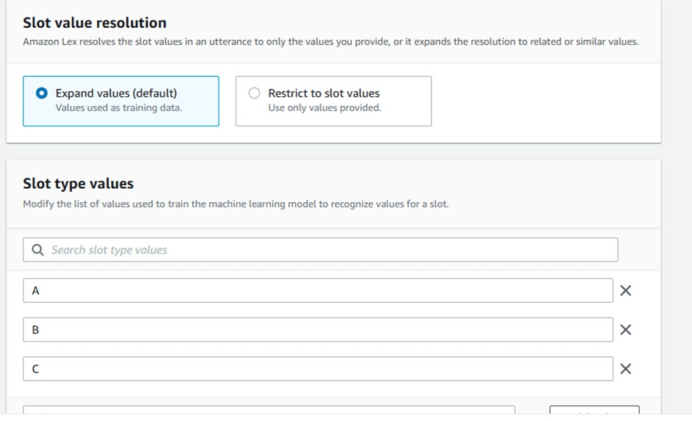
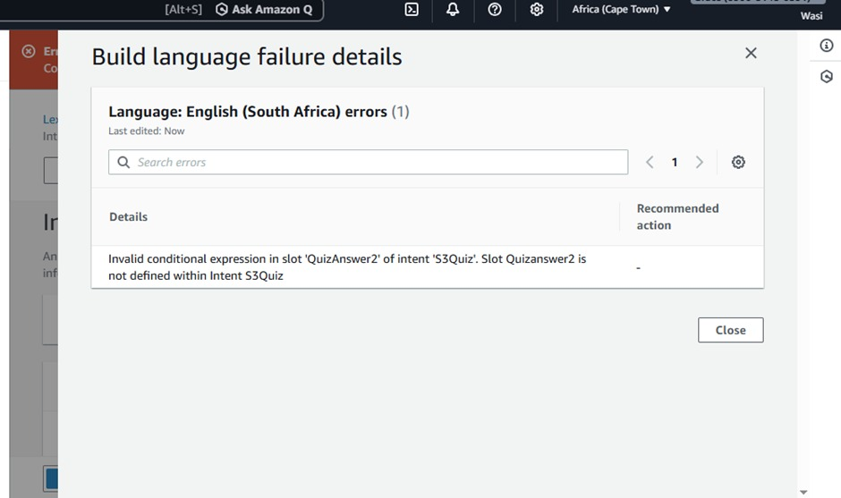
Challenges We Faced
1
Challenge 1 — Exact Slot Naming
Problem: Slot values had to match exactly — incorrect wording prevented the bot from working.
Solution: Standardized slot values and responses throughout the bot configuration.
2
Challenge 2 — Slot Type Confusion
Problem: Initially tried creating custom slot types which caused unexpected errors.
Solution: Discovered and used pre-configured Amazon Lex slot types instead.
Presenter: Grace
9 / 11

Slide 10
Key Takeaways
🤖
Amazon Lex enables AI-powered conversational interfaces
📚
Chatbots can enhance interactive learning platforms
⚙️
Proper configuration of intents, slots, and utterances is critical
This project demonstrates how AWS AI services can be used to build scalable educational tools.
Presenter: Grace
10 / 11

Slide 11
AWS Lex Chatbot
CloudLearners Inc.
Questions?
Thank you for listening.
We welcome any questions.
Phenyo
Tumelo
Nhlanhla
Grace

